Slide 1
E-LIBRARY
WEBSITE
Enrich your knowledge

Slide 2




TABLE OF CONTENTS
Where knowledge begins
2) Objective
Benifits of E-Library
4) Methodology
Brief Description about Project
6) Our Teams
Our Group Members.
1) About the project
Introduction about the Project
3) Requirements
Technology used & Platform specification
5) Screenshorts
Sneak Peak of the Project

Slide 3

Library park
Libraries draw in individuals to peruse and create a propensity for perusing and learning. It builds their hunger for perusing and extends information.

Slide 4
ABOUT THE PROJECT
The name of the project is E-LIBRARY WEBSITE.
This project includes all the details about the entire software requirements, specification for the
software and database for E-Library center.
The purpose of this project is to provide easy learning facility online .

Slide 5
OBJECTIVE
Design Library Services that keep users at the forefront of individualized liberal arts and professional education.
A heightened amount of choice. Instant access to educational content. An easier information retrieval.

Slide 6
REQUIREMENTS
Hardware Specification
Processor: Pentium 1.0 GHz or higher RAM: 1024 MB or more
Minimum Space Required 100 MB Display 16-bit color
Storage: 10GB or more
Software Specification
Operating Environment Win 2000/XP Platform .Net Framework & IIS Visual Studio 2008
Database SQL Server 2005 XAMPP server
Any Browse

Slide 7
TECHNOLOGY USED
JAVASCRIPT 11.1%
DATABSE (PHP, MYSQL) 11.1%
Web Design (HTML) 44.4%
CASCADING STYLE SHEET (CSS) 33.3%

Slide 8
Methodology
E-library is a form of electronic Library store where the reader is directed online to the Books place computer usually via the internet. There is no intermediary service. The sales and purchase transaction is completed electronically and interactively in real- time. The development of this new system contains the following activities which try to develop on-line application by keeping the entire process in the view of database integration approach. User gets its email id and password to access their account.
Administrator of library System has multiple features such as Add, Delete, Update Books.

Slide 9
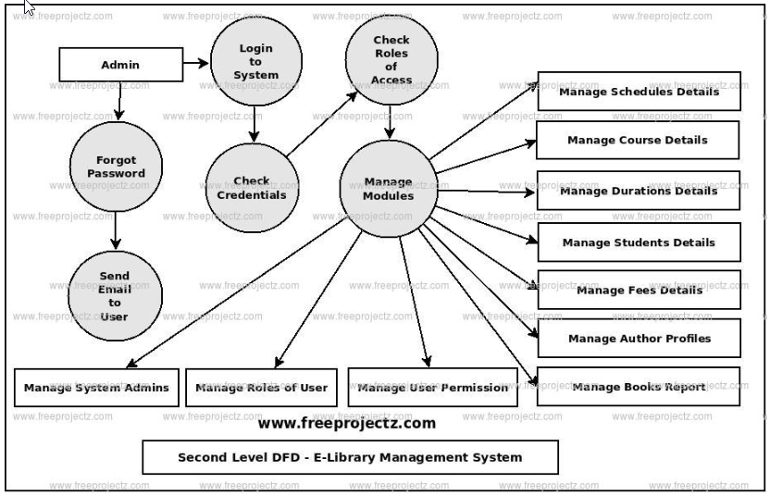
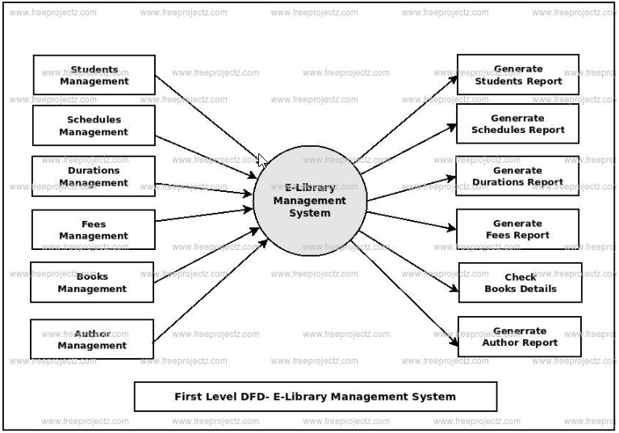
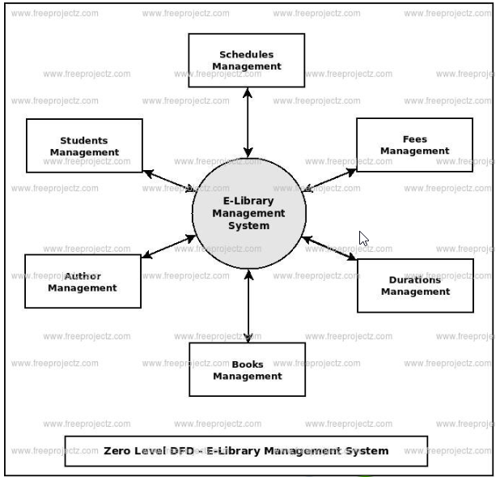
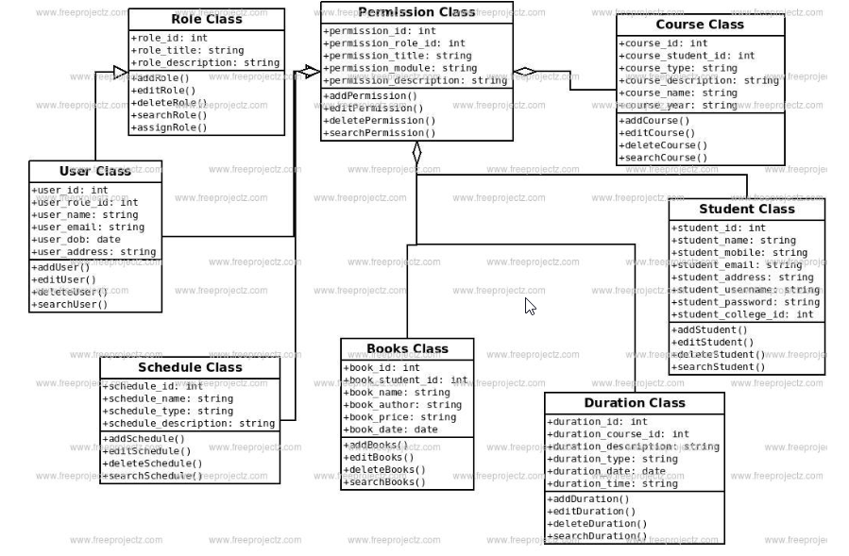
DIAGRAMS
DFD SECOND LEVEL
DFD FIRST LEVEL
DFD ZERO LEVEL
CLASS DIAGRAM

Slide 10
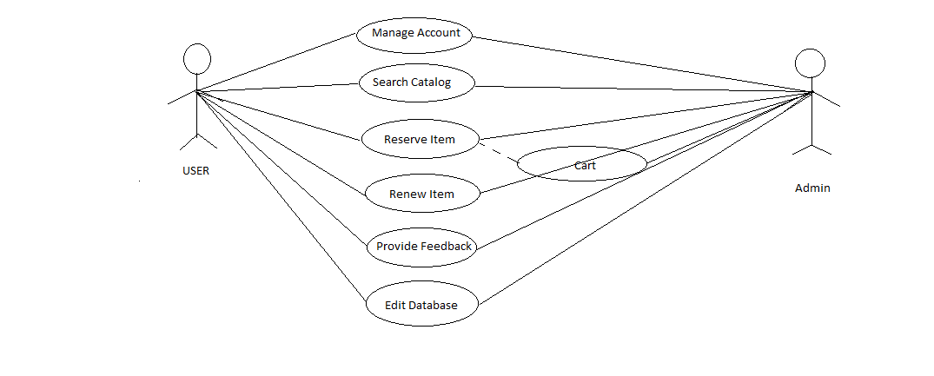
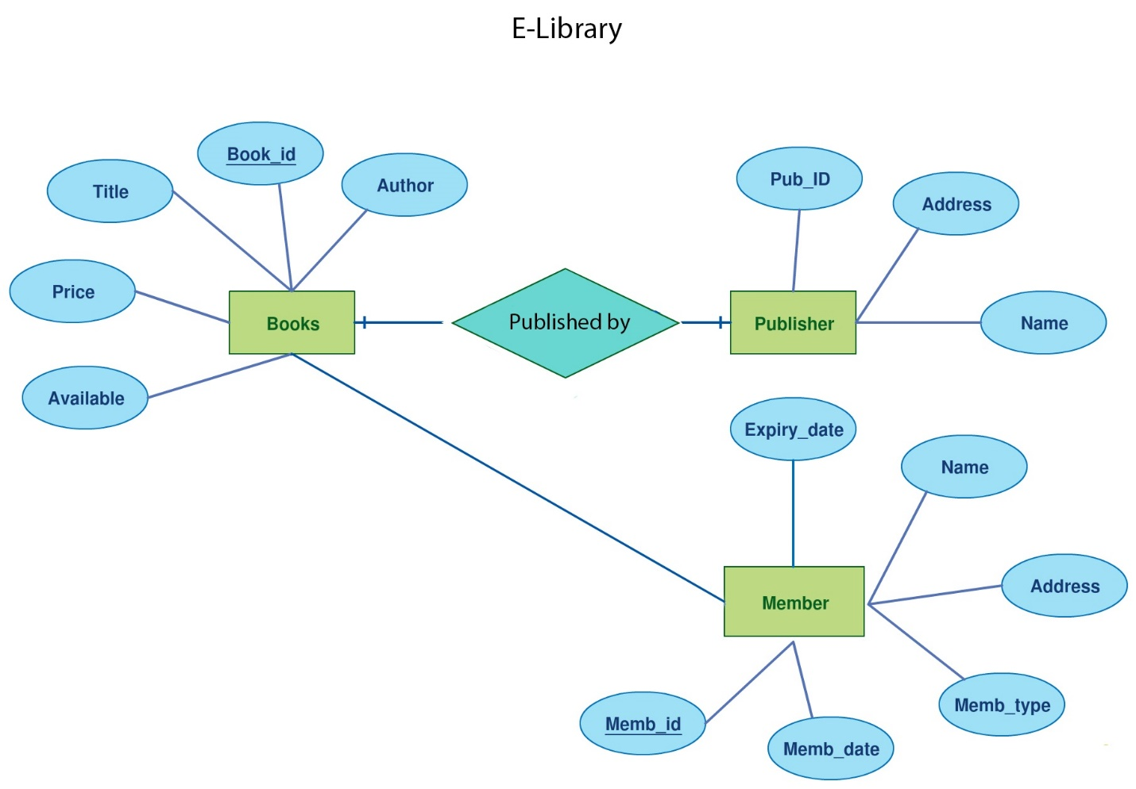
DIAGRAMS
USE CASE DIAGRAM
E-R DIAGRAM

Slide 11
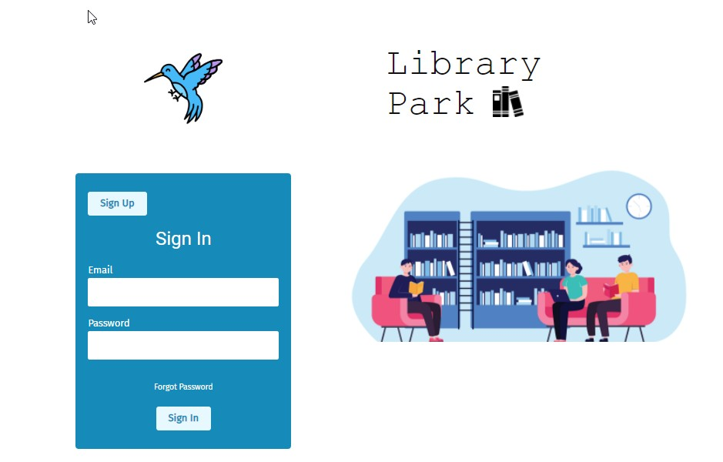
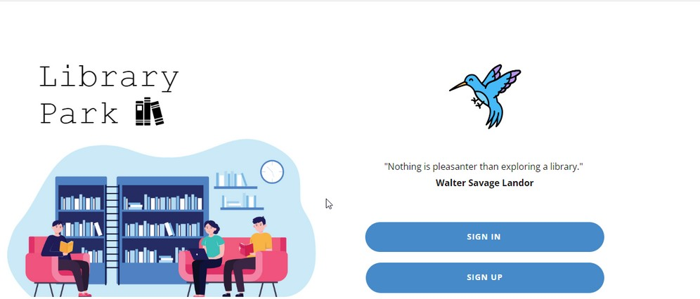
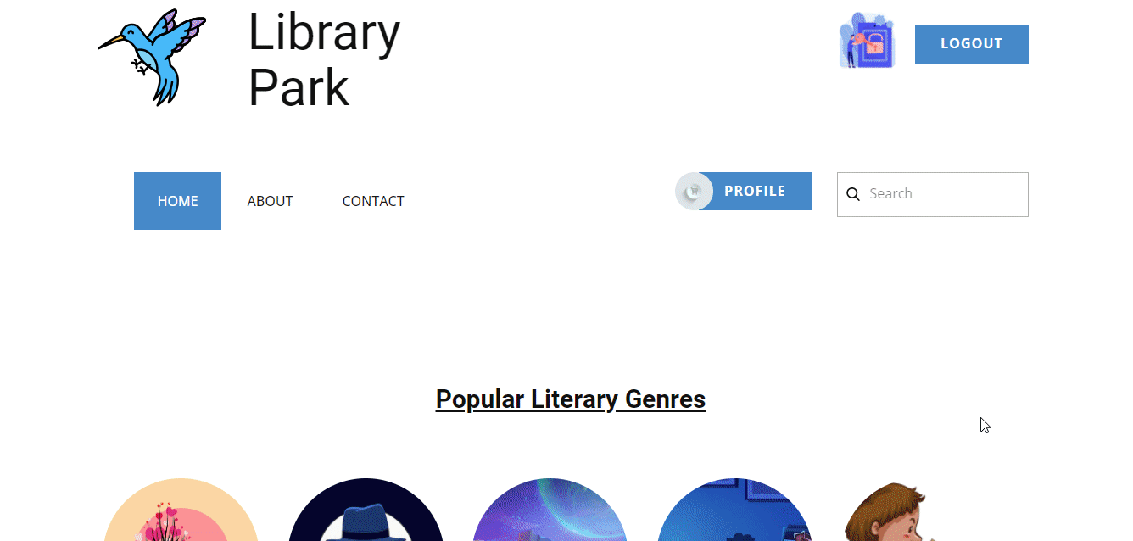
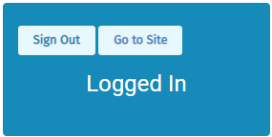
SNEAK PEEK

Slide 12
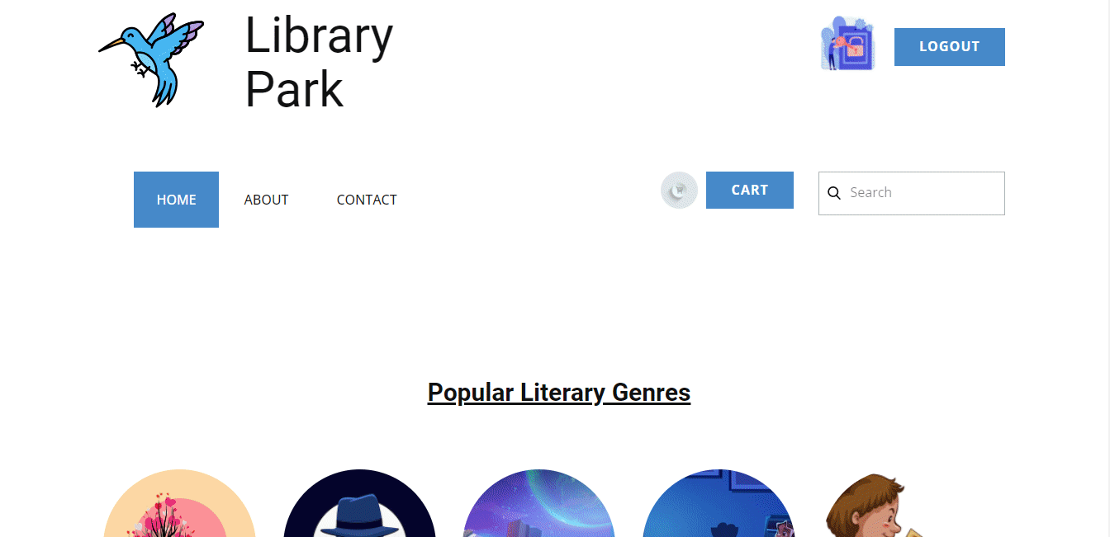
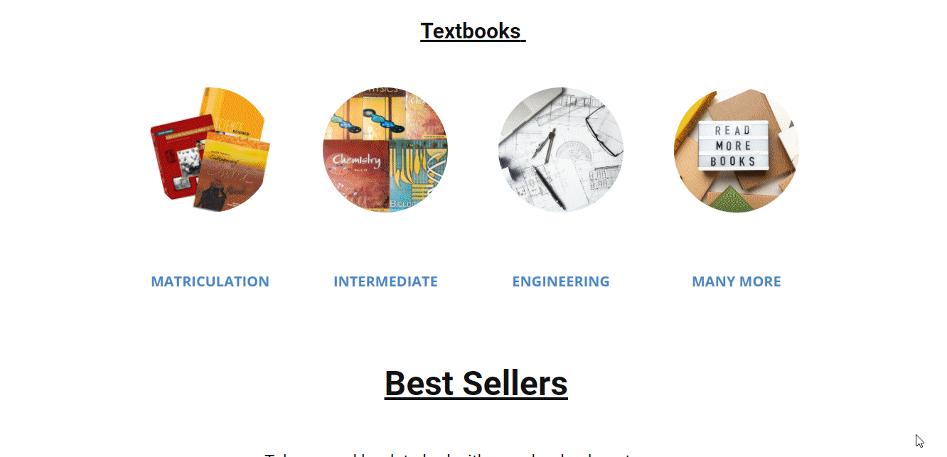


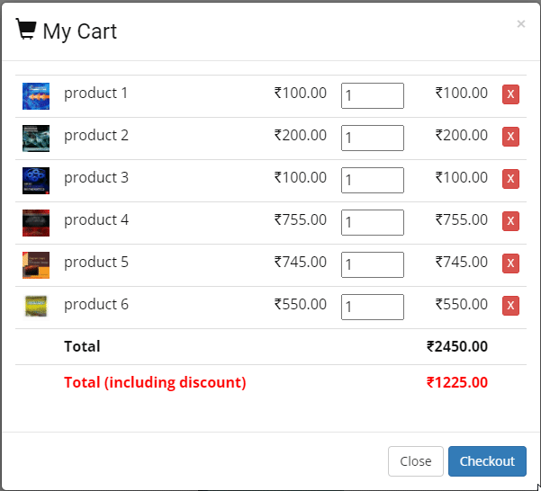

Slide 13
OUTCOMES
Large-scale digitization of scholarly journals
Some early defining projects that established the value of digitization
National library programs for cultural heritage materials
Contributions to preservation
The emergence of digitization specialists and best practices

Slide 14



The Team Introduction
SHASHI RANJAN
20BCS5318
YUVRAJ SINGH
20BCS5353
AVI MEHTA
20BCS5341

Slide 15

FOR ANY QUERY!!
Contact us –
Whatsup: 9517107998
Linkedin: https://www.linkedin.com/in/shashi-ranjan-643392226/
Instagram: https://instagram.com/avi.mehtaa?igshid=YmMyMTA2M2Y=

